Slide 1
House price Prediction with Zillow Economics Dataset
Jered Ataky & Zhouxin Shi

Slide 2

One of the big decisions to make in life is purchasing a home. There are many factors that need to be taken into consideration while making such a decision. In this project, we tend to retrieve data from different data sources. The data will have metrics such as median income, unemployment rate, public schools, hospitals, hospital ratings, crime rate, … Our task will be to get data from those multiple data sources using different methods (read csv, web scrapping…) learned throughout the course of this class, to store them (on a database, cloud,…), to clean and transform them, and to analyze and visualize them to get some useful information for houses price. We will then go further on using different models to predict the house price based on different features that we would find are necessary and weight on houses price.
One of the big questions that we ask ourselves is : “Which variable is a best predictor of housing prices?”

Slide 3
Data use for this project
1) Zillow Economics Dataset
https://www.kaggle.com/zillow/zecon
2) School Dataset — USA Public Schools
https://www.kaggle.com/carlosaguayo/usa-public-schools
3) Hospital Dataset
https://www.kaggle.com/carlosaguayo/usa-hospitals/version/1
4) Hospital Rating Dataset
https://www.kaggle.com/center-for-medicare-and-medicaid/hospital-ratings
5) Unemployment Dataset — USA Unemployment rate Dataset
https://www.kaggle.com/carlosaguayo/2018-unemployment-rate-by-county/version/1

Slide 4
Challenges
1) Zillow Economics dataset — Difficulty in finding appropriate dataset from Zillow to work on as no description is easily available. Though Data dictionary is available it does not specify every dataset included in the Zillow Economics dataset. No details about the various csv files and how they are related to each other and the details about different attributes.
2) Finding out what is FIPS, FIPS_ST, FIPS_CT and how to relate it with counties or ZIP code
3) Finding appropriate datasets for various factors like schools, income levels, hospital ratings, unemployment rating etc. After lot of searching found the datasets which could be used in this project.
4) How to merge all these datasets to make them one useful dataset for prediction of house prices based on factors — Schools, Hospitals, Unemployment rate etc.

Slide 5
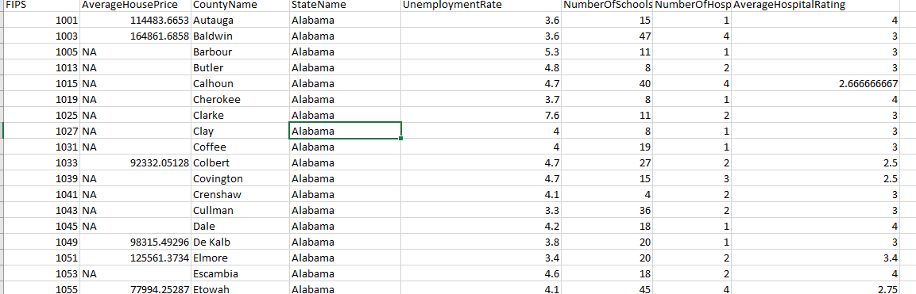
Combine Data from all source

Slide 6
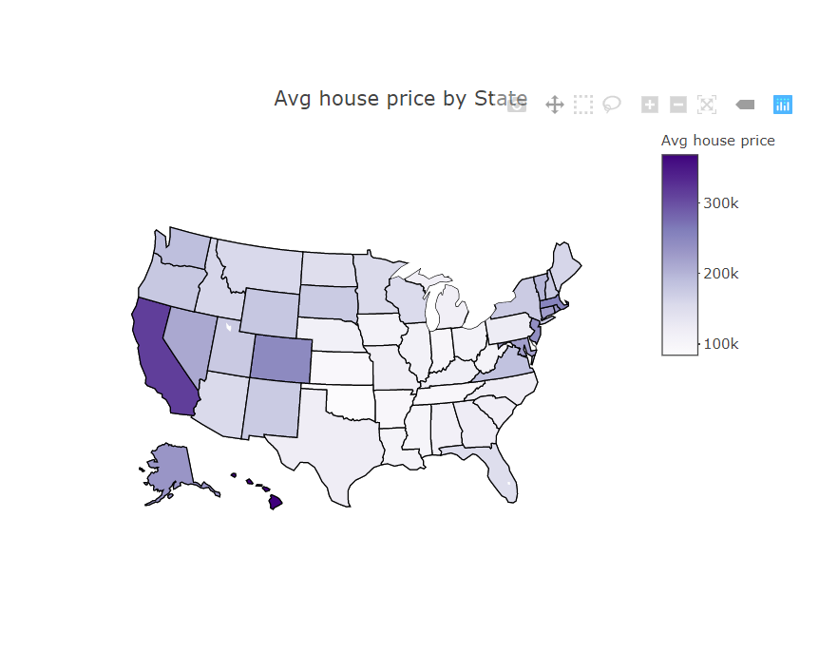
Median Home value per square foot in different states

Slide 7
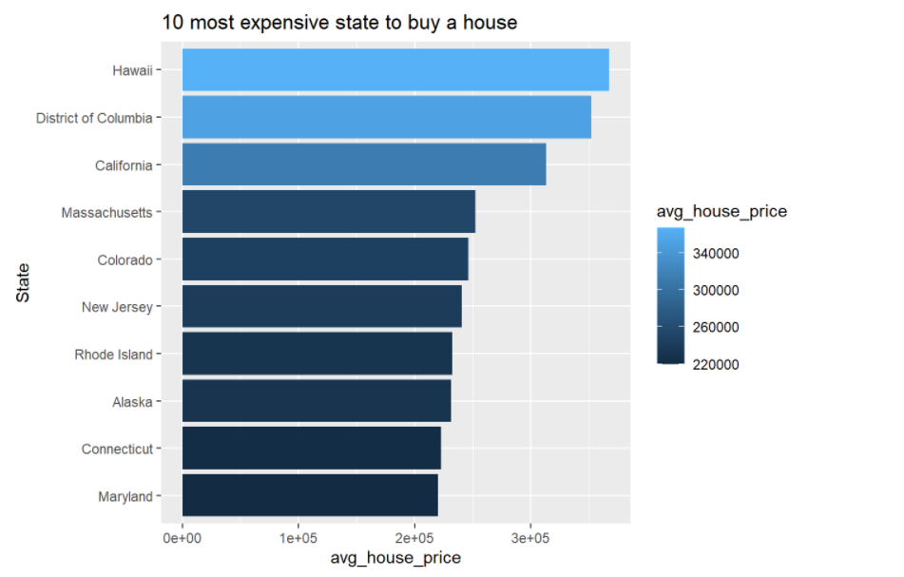

Slide 8
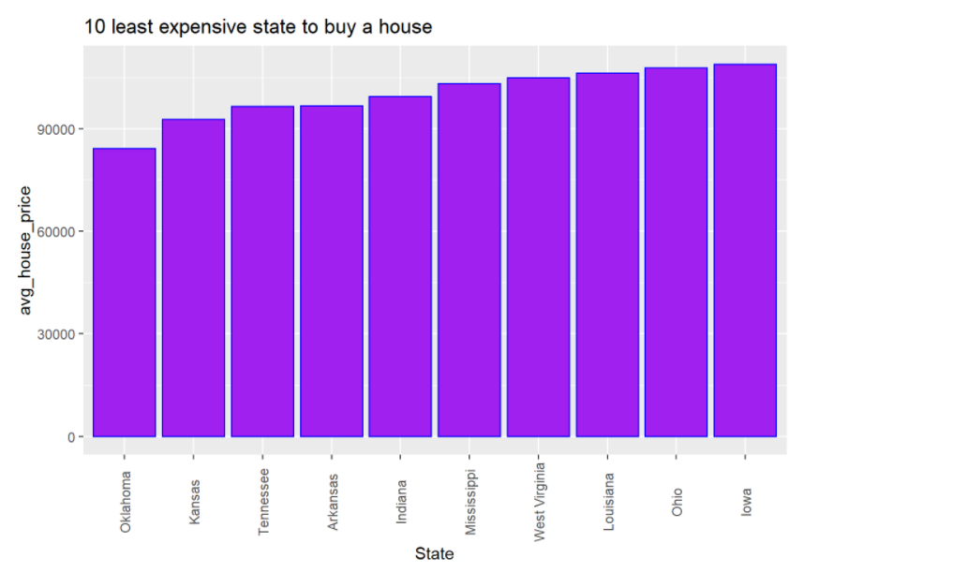
10 least expensive state to buy houses

Slide 9
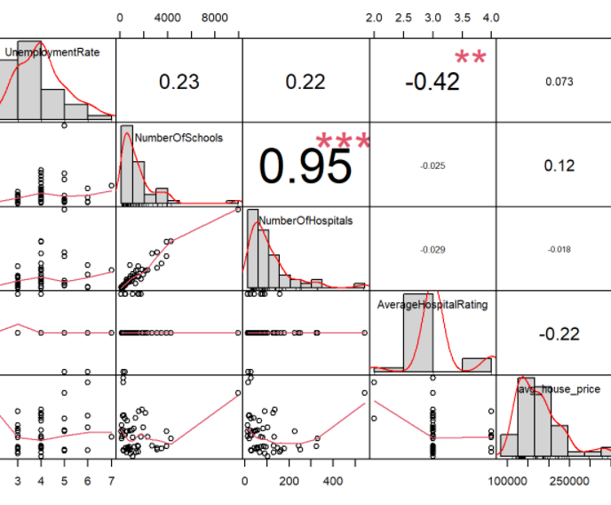
Correlation Matrix with different factors and House Price

Slide 10
Conclusion
As to answer to our main question to test around relationship between housing prices and each predictors, We realize that the house price has a positive relationship with the number of schools and the unemployment rate. Those are also the two big factors (from the features we explored) that contribute the most to the price of home in US. The two other factors have a negative relationship with house prices. Though the predictors we used, we should have taken into consideration the crime rate which we believe should be a great predictor of home price. This will be part of further work we will have to do to make this model more efficient. We need also to mention that the project presented some challenges such as we needed to find appropriate data set for various factors, understand different terms such FIPS which we never heard before, merge different data set to make one useful data set for analysis and prediction.

Slide 11
Reference
https://www.kaggle.com/zillow/zecon
https://www.kaggle.com/carlosaguayo/usa-public-schools
https://www.kaggle.com/carlosaguayo/usa-hospitals/version/1
https://www.kaggle.com/center-for-medicare-and-medicaid/hospital-ratings
https://www.kaggle.com/carlosaguayo/2018-unemployment-rate-by-county/version/1

